Slide 1
WARC Portal
Cheng Chen | Kevin Tang | Mate Verunica | Adriano Marini
CMPUT 401 F16

Slide 2
The WARC portal project aims to deal with extracting, searching and analyzing web archive files. We provide intuitive and easy access for researchers to browse and search through thousands of possibly duplicated webpages, provide tools for analyzing their collections using an array of searches and filters, and provide helpful visualizations of their data by analyzing keywords.

Slide 3
Purpose and Value
Researchers have crawled web archives, called WARCs
Disassembling and analyzing them can be a chore; We have automation!
Provides insights into a body of data that might be collected related to specific sources
Use Case: Analyzing crawled articles related to the Fort McMurray Fires in 2016

Slide 4
Architecture: Overview
Three main elements:
Front End UI
Back End Server
Packages for Analysis and Display

Slide 5
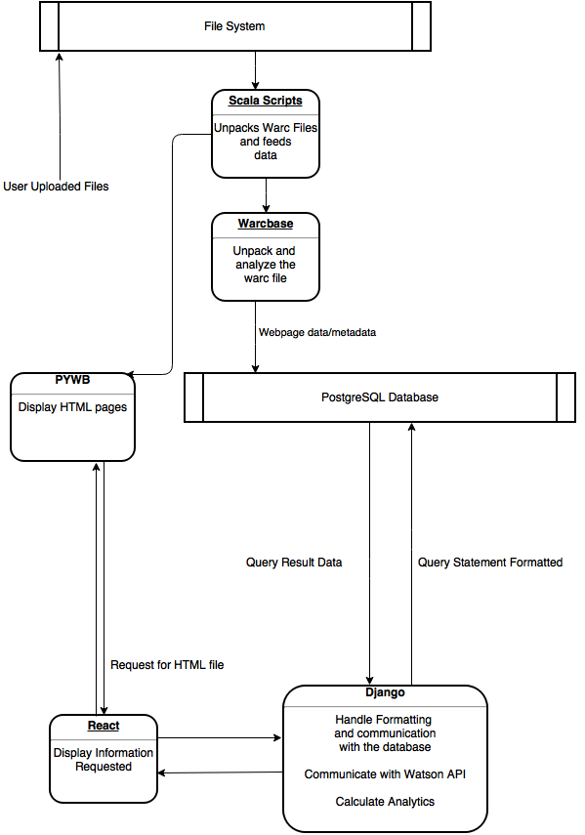

Slide 6
Architecture: Front End
Using the React Framework
With added Redux
Creates the search and display framework
Plays nicely with Django

Slide 7
Architecture: BACK End
Django server
In combination with a PostgreSQL Database
Implements:
TF-IDF Visualizations
Collection management
Talking to Watson’s API for insights into documents
Among other standard functions

Slide 8
Architecture: Other Packages
WARCbase
Developed by CS @ Waterloo
Running on top of Apache Spark, uses Hadoop and Scala to analyze WARC files.
Scala scripts feed files into WARCbase for analysis
Good level of Automation

Slide 9
Architecture: Other Packages
Pywb
Open Source package to view the archived webpages
Customized UI
Builds its own indexes on the files

Slide 10
Architecture: Other Packages
D3
Creates word-cloud visualizations
TF-IDF Ranking
CRON scripts
Automate file crawling and intake

Slide 11


Slide 12
Key Challenges
Lack of documentation. . .
Understanding a complex architecture
Dirty / Bad data
Resource restrictions
Language / Technology Support
MySQL’s lack of Unicode Support

